Slide 1

Capstone Project – Final Presentation Date: December 8th, 2025

Slide 2
1
2
3
4
6
7
8
Executive Summary & Key Recommendations
Project Overview & Client Questions
Team Recognition / Sponsors
Sale Performance & Recommendations (VMR)
Appendix Highlights
Executive Summary – Call to Action
Q&A and Discussion
Future Demand Patterns, Risks & Opportunities
5
AGENDA

Slide 3
Executive Summary & Key Recommendations
1
Situations
KLESK needs a unified way to explain past performance, anticipate shifts, and plan for growth.
Key Questions
What can we learn from historical custom and part-level sales & profit performance?
Recommendations
Institutionalize VMR Review
This project provides tools and insight to support visibility, foresight, and strategic action.
What can we confidently forecast about future demand patterns and risks?
How do we identify and plan for revenue growth opportunities?
Monthly waterfall-based reviews to monitor volume, mix, and rate drivers.
Strengthen Forecasting Use
Quarterly forecast review to detect cycles early and engage accounts proactively.
Act on Underperforming & Downward-Trend Parts
Apply targeted interventions such as pricing alignment, bundling, upsell strategies, or account outreach to stabilize volume and unlock incremental growth

Slide 4
Project Overview & Client Questions
2
VMR
Historical custom and part-level sales & profit performance
Forecast Overview
Anticipating Sales &Ships
Sales Forecast Analysis
Revenue growth
Volume Forecast Analysis
Future volume demand and resources planning.
demand and opportunities
Anwer Questions…
Forecasting Dashboard User Logic
Dashboard Sections...
Forecast dashboards are designed to solve actual business questions, and the use can us the number from dashboards for higher executive need.
4

Slide 5

Team Recognition / Sponsors
3
PROJECT TITLE: Performance & Forecasting: Customer and Part Number Volume, Rate and Mix
UST OPUS CAPSTONE – FALL 2025
UST OPUS Consulting Team
Crystal Anderson
612-387-5329 | ande0170@stthomas.edu
Morgan Meng
763-388-5845 | meng7675@stthomas.edu
Irene Y. Popa
952-212-9549 | popa8654@stthomas.edu
Aboubacar Tanimoune
507-351- 9234 | tani8989@stthomas.edu
Zhihao (David) Zhou
763-318-9982 | zhou2098@stthomas.edu
Executive Sponsor
952-457-5835 | jeffm@kleskmetalstamping.com
Project Primary POC
952-457-5835 | jeffm@kleskmetalstamping.com
SME’s Contact Number
612-331-8792
Business Solutions Lead
timc@kleskmetalstamping.com
Business Solutions Manager rachelp@kleskmetalstamping.com
ERP Project Manager
jeffa@kleskmetalstamping.com
5

Slide 6
Sale Performance & Recommendations (VMR)
4
VMR Overview
Collins Aerospace
Sales Performance
Recommendations
Emerson
Sales Performance
Recommendations

Slide 7

VMR Overview: Objectives and Structure
Objective​
Explain sales performance changes between two comparable periods (e.g., 2024 YTD vs.2025 YTD).​
Attribute total sales change to Volume, Mix, and Rate drivers.​
Key Definitions​ V-M-R
Volume: Change in total units sold, valued at prior-period prices.​
Mix: Change in product or customer composition with different value profiles.​
Rate: Change in average selling price per unit (price effect).​
Reporting & Implementation:
Dynamic filters (Period comparison, Customer and Part Segments)
Waterfall chart for Volume/Mix/Rate
Power BI integration​ scalable for future enterprise integration
The project team has implemented the client-defined VMR framework in Power BI with robust, scalable calculation logic designed to support future expansion across KLESK’s entire book of business.

Slide 8
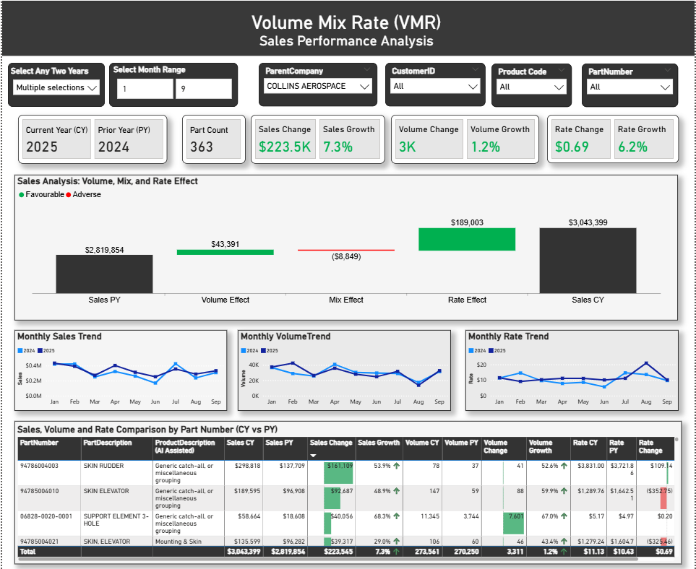
VMR Overview: Volume-Mix-Rate (VMR) Dashboard Snapshot
VMR dashboard is designed for clarity and interactivity, combining high-level KPIs, visual breakdowns (waterfall and trend charts), and detailed tables with dynamic filters to enable comprehensive Volume, Mix, and Rate analysis across any two periods.

Slide 9
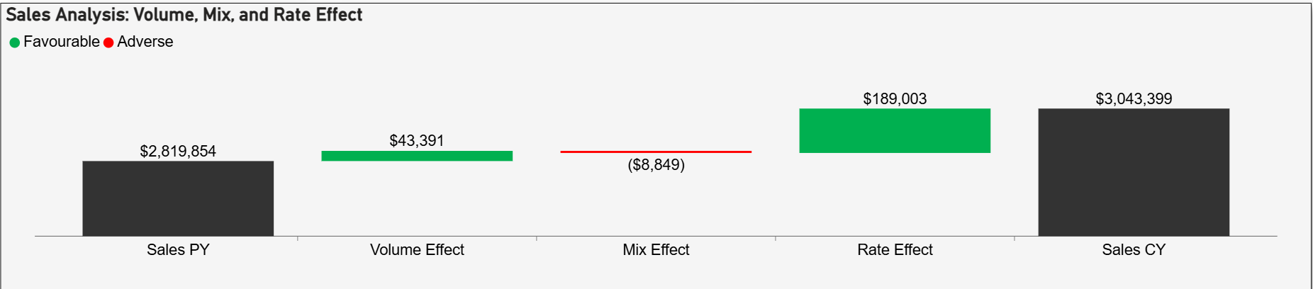
VMR: Collins Aerospace- - Sales Performance Analysis
Years: CY 2025 vs PY 2024; Months 1–9
ParentCompany: COLLINS AEROSPACE | CustomerID: All| Product Code: All | PartNumber: All
Part Count: 363
Sales Change = Sales CY – Sales PY = $223.5K
Collins’ sales increased by $223.5K from $2,819,854 in the prior year (2024) to $3,043,399 in the current year (2025).

Slide 10
VMR: Collins Aerospace- - Sales Performance Analysis
Years: CY 2025 vs PY 2024; Months 1–9
ParentCompany: COLLINS AEROSPACE | CustomerID: All| Product Code: All | PartNumber: All
Part Count: 363
Sales Change = Sales CY – Sales PY = $223.5K
The Volume Effect contributed $43,391 to the overall sales increase

Slide 11
VMR: Collins Aerospace- - Sales Performance Analysis
Years: CY 2025 vs PY 2024; Months 1–9
ParentCompany: COLLINS AEROSPACE | CustomerID: All| Product Code: All | PartNumber: All
Part Count: 363
Sales Change = Sales CY – Sales PY = $223.5K
Price changes added $189,003 to sales (favorable), while product mix reduced sales by $8,849 (adverse), so pricing was the main driver of the overall increase.

Slide 12
VMR: Collins Aerospace- - Sales Performance Analysis
Sales grew by $223.5K (7.3%), driven mainly by a 6.2% increase in rate, while volume growth was modest at 1.2%, showing that price improvement was the primary driver of overall performance.

Slide 13
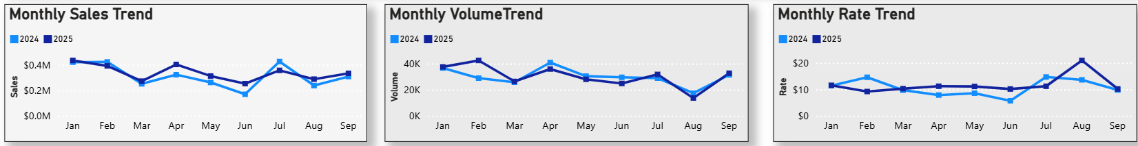
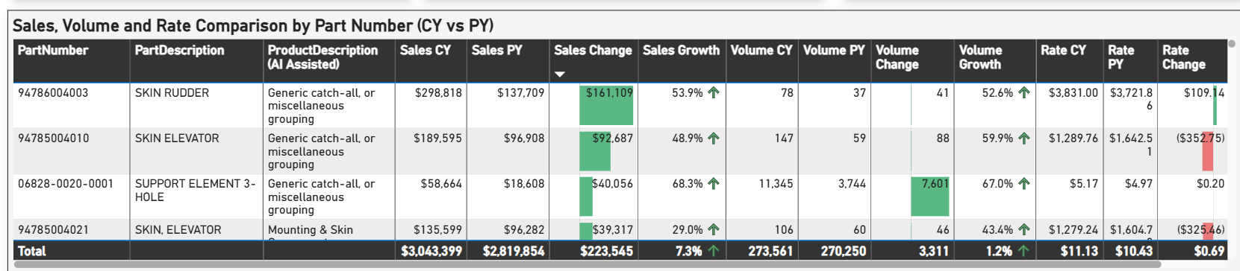
Sales, volume, and rate trends stayed relatively stable month to month, with overall growth driven by a few high-performing parts

Slide 14
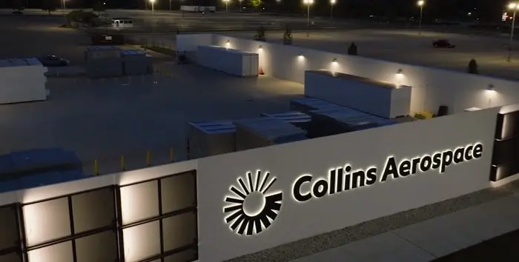
VMR: Collins Aerospace- - Sales Performance Summary
Sales Growth Overview​
Sales increased by $223.5K, a 7.3% rise compared to last year, driven mainly by pricing adjustments.​
Impact of Rate Effect​
Rate Effect contributed $189K, about 85% of growth, demonstrating successful price strategy implementation.​
Volume and Mix Effects​
Volume growth added $43.4K from 3,000 units; Mix Effect reduced sales by $8.8K due to product shifts.
Collins’ sales grew 7.3% mainly because prices improved (rate +$189K ≈ 85% of growth), with a small boost from volume and a slight drag from product mix.

Slide 15
VMR: Collins Aerospace- - Recommendations
Establish Monthly VMR Reviews​
Set up monthly VMR review process using waterfall charts and variance alerts to maintain visibility and improvement.
Leverage Pricing Strategy Further
Since 85% of growth came from rate effect, continue refining pricing models and explore dynamic pricing to maximize revenue.
Boost Volume Growth
Volume added $43.4K, but there’s room for improvement. Consider targeted marketing or expanding production capacity to increase unit sales.
Address Mix Effect Losses
Mix effect reduced sales by $8.8K due to product shifts. Analyze product portfolio and customer preferences to optimize mix and reduce negative impact.
Diversify Growth Drivers
Current growth is heavily price-driven. Invest in innovation and customer experience to create sustainable, long-term growth beyond pricing adjustments.
Focus on strengthening pricing strategies while improving volume growth and optimizing product mix to ensure balanced and sustainable sales performance.

Slide 16

EMERSON: RECOMMENDATIONS
Strategic advice to enhance performance and growth

Slide 17
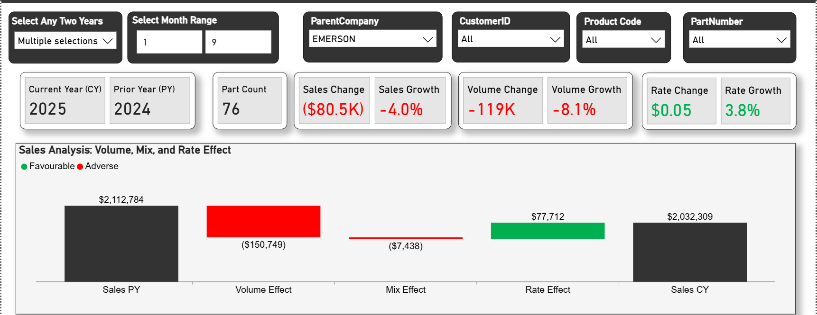
VMR: Emerson - Sales Performance Overview
• Sales Growth Overview
Sales decreased by $80.5K, a 4.0% decline compared to last year, mainly due to lower shipment volumes.
• Impact of Rate Effect
Rate Effect contributed +$77.7K, showing that price adjustments helped offset some of the decline.
• Volume and Mix Effects
Volume Effect reduced sales by $150.7K from 119K fewer units; Mix Effect further reduced sales by $7.4K due to product composition changes.

Slide 18
VMR: Emerson - Recommendations
Establish Monthly VMR Reviews​
Set up monthly VMR review process using waterfall charts and variance alerts to maintain visibility and improvement.
Recover Volume
Focus on increasing shipments through targeted promotions and improved supply chain efficiency.
Preserve Pricing Gains
Maintain the positive rate effect by continuing strategic pricing without heavy discounting.
Improve Product Mix
Promote higher-margin products to offset mix-related losses.
Strengthen Demand Planning
Align inventory and production to prevent future volume shortfalls.
To reverse the sales decline, prioritize recovering shipment volumes while maintaining pricing gains and improving product mix for sustainable growth.

Slide 19
Future Demand Patterns, Risks & Opportunities (Forecast)
5
Forecast Case Study: Collins Parts
Medium Confidence
3 Case Studies
Recommendations
Low Confidence
Analysis
Recommendations

Slide 20
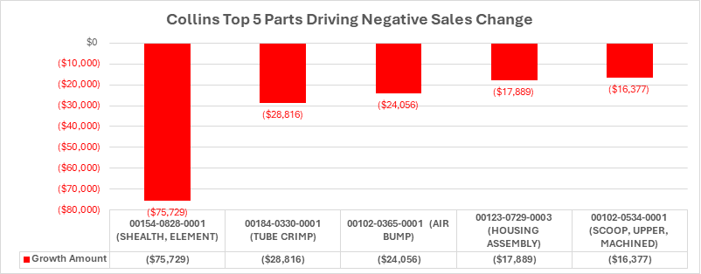
Forecast Analysis: Collins Aerospace-Parts With Downward Trends
Why Downward Trend Parts?
Showing downward demand or underperformance present targeted improvement opportunities
Parts currently showing downward pressure or forecast uncertainty are high-priority intervention candidates
Low-confidence and downward-trend parts are signal flares: the data highlights where corrective action can yield disproportionate return if acted upon early.
Focus attention on parts trending downward.
These segments require deliberate intervention — renewal conversations, product positioning, or stocking adjustments — to prevent erosion and unlock rebound potential.

Slide 21

Forecast Analysis: Collins Aerospace-Parts With Downward Trends
Low Confidence Parts
Median Confidence Parts
Although all five parts show negative growth, their confidence levels differ—low-confidence parts should be interpreted and acted on differently than median-confidence ones.

Slide 22
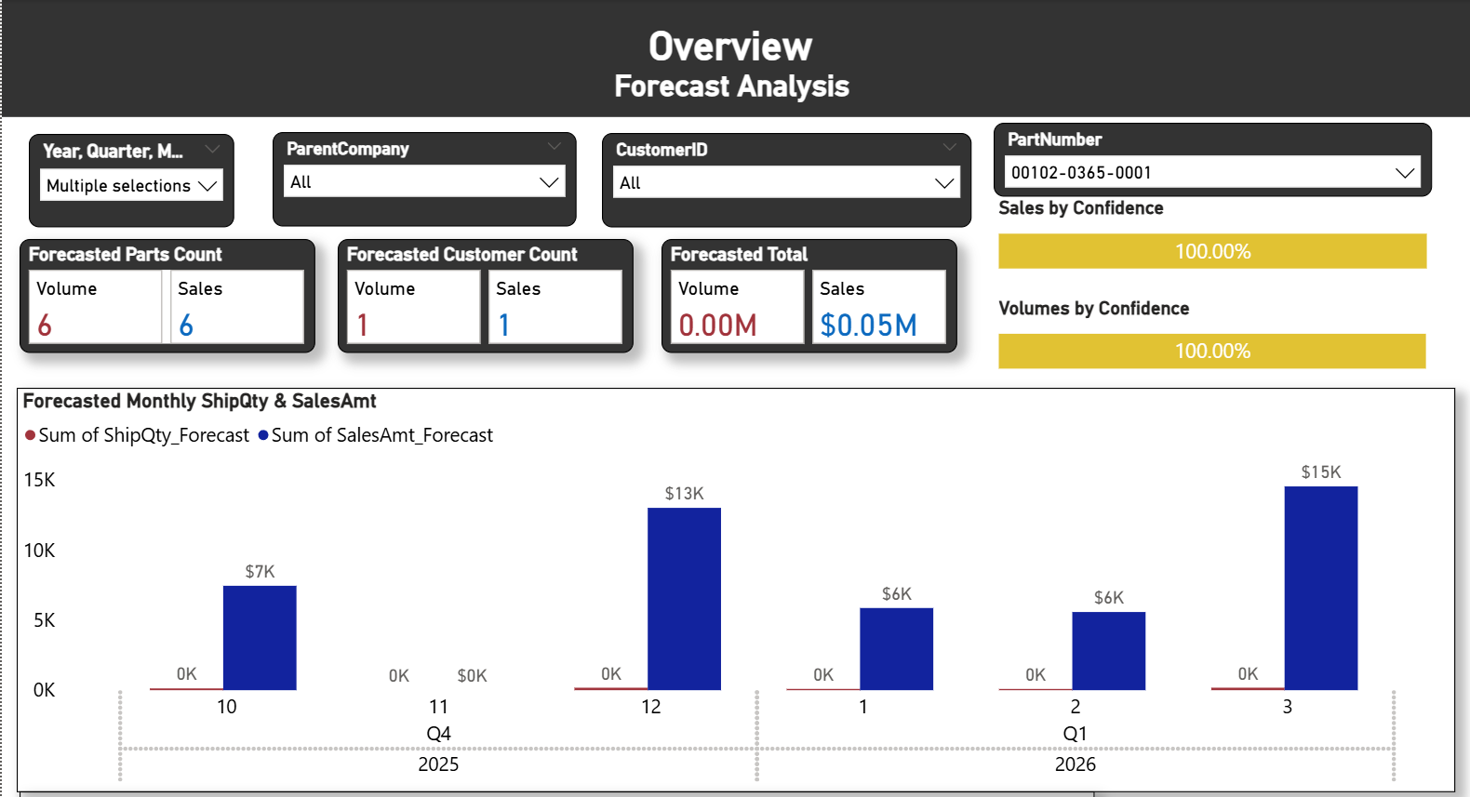
Forecast Analysis: Collins Aerospace- Medium Confidence Parts
Median Confidence ensures trustworthy forecasts.
The part shows a gentle but consistent downward trend across multiple Q1 cycles, suggesting demand has passed its peak and may be entering a lower phase of its multi-quarter seasonal cycle.
Monitor for continued softening—this part may be entering a long-term low in its multi-year cycle.

Slide 23
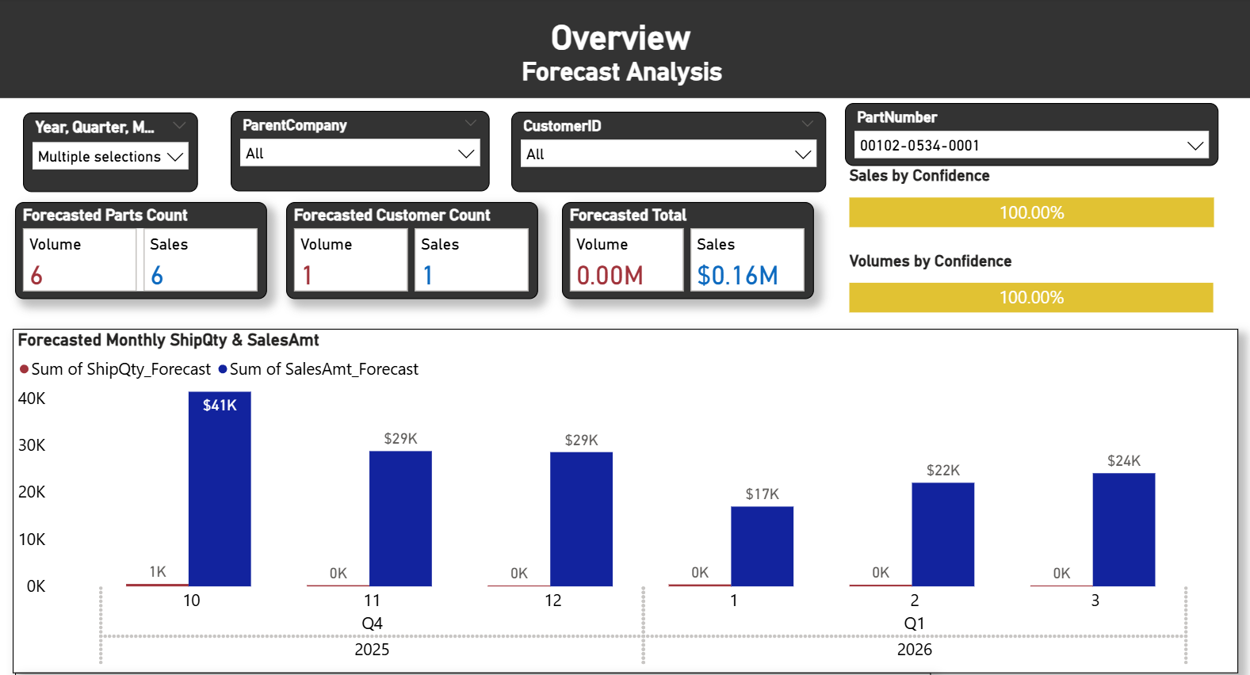
Forecast Analysis: Collins Parts- Medium Confidence Parts
Median Confidence ensures trustworthy forecasts.
After peaking in 2024, this part appears to be moving through a normal demand cycle. Compared to prior Q1s, both volume and rate have returned to mid-range levels, indicating a softening but not a severe decline.
Stable mid-range performance suggests maintaining current levels with periodic quarterly review.

Slide 24
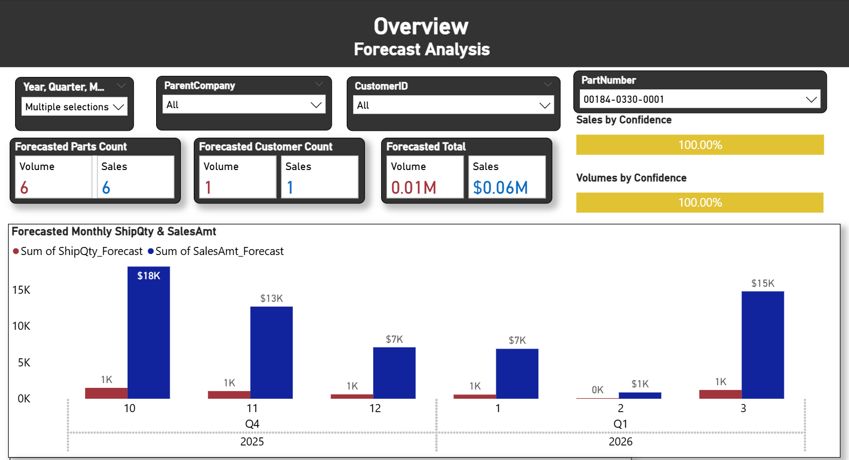
Forecast Analysis: Collins Aerospace- Medium Confidence Parts
Median Confidence ensures trustworthy forecasts.
The product shows pronounced intra-quarter fluctuations, with Q1 demand historically dipping. While a decline is forecasted for 2026 Q1, the longer-term trend continues upward. This part warrants closer observation alongside Goodrich Bangali’s demand signals.
Seasonal dips are normal—track Goodrich Bangalore closely as their demand drives this part.

Slide 25
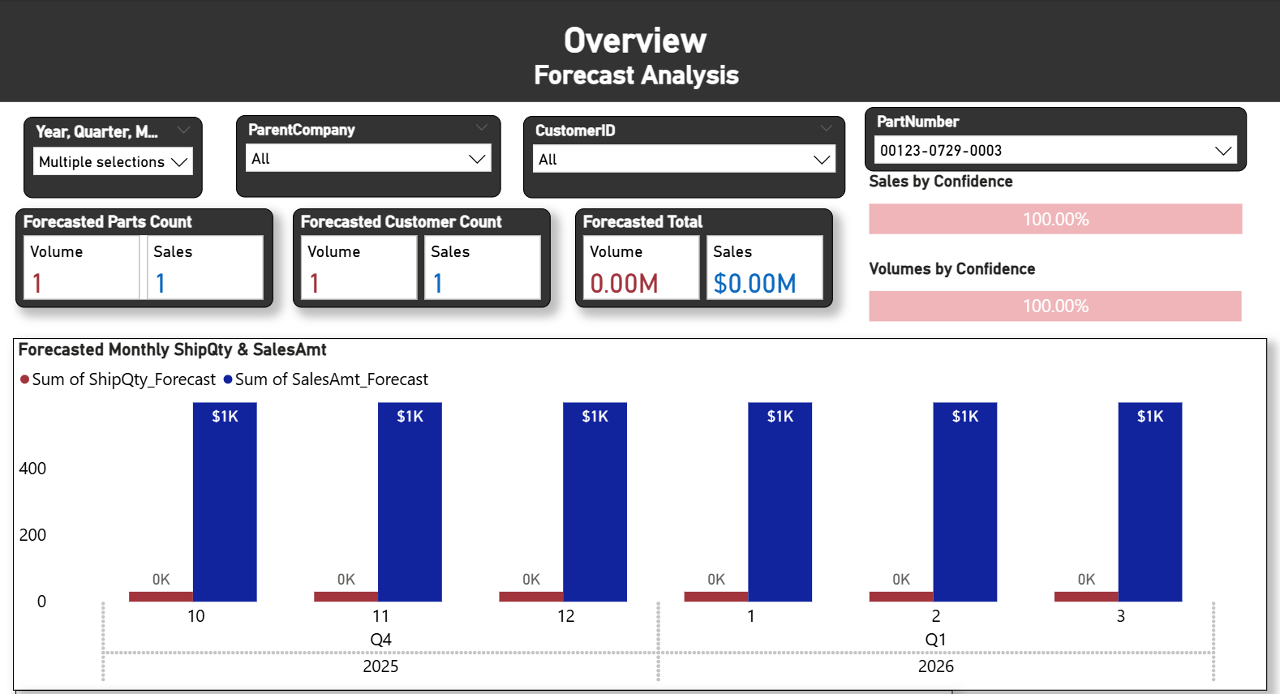
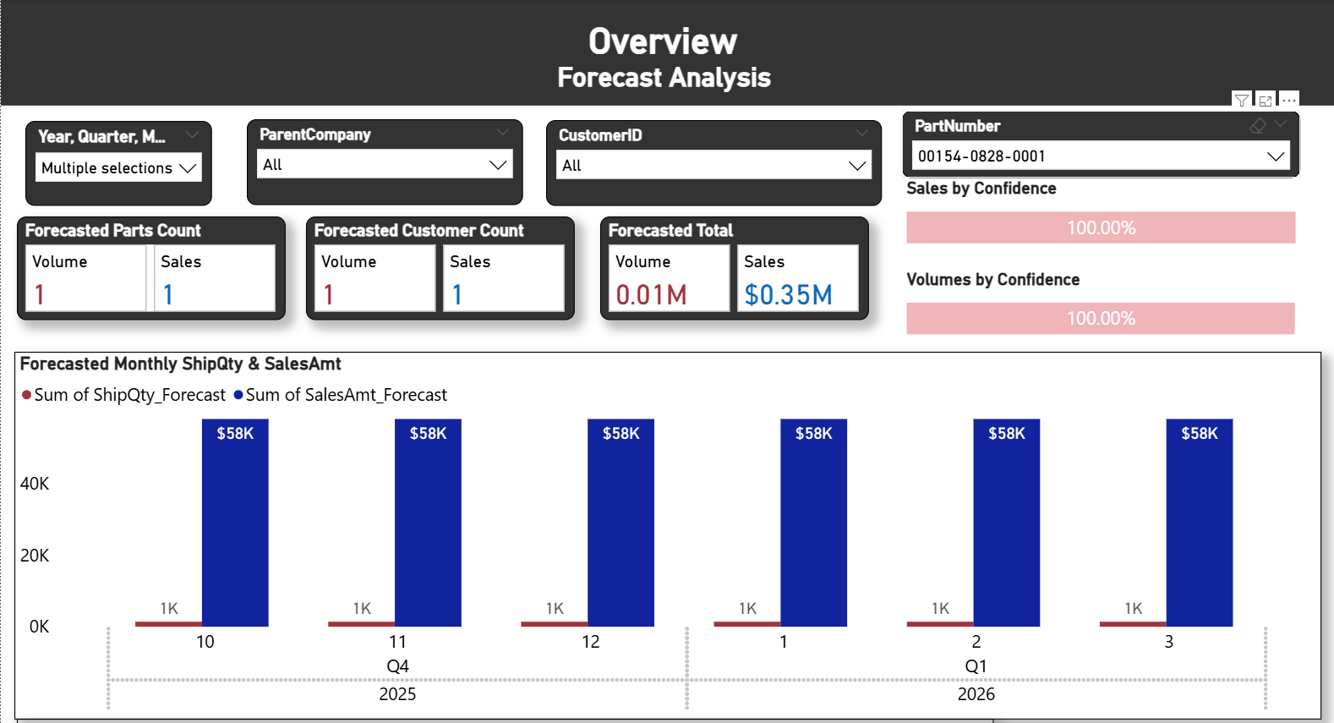



Forecast Analysis: Collins Aerospace- Low Confidence Parts
These parts exhibit low forecast confidence due to a small sample size. As more data becomes available, the underlying trend will become clearer and model accuracy will improve.
Lower Confidence requires more data feeding
Model
Data
Reliable Forecast
Low confidence reflects limited history—continue feeding data to improve model accuracy.

Slide 26
Forecast Analysis: Recommendations for Parts with Downward Trends
Establish Quarterly Forecast Reviews​
Set up quarterly forecast review process using line charts to visualize trends and detect forecast changes. When possible, refresh customer forecast making a blended forecast available.
Anticipate Demand Shifts
Start by reviewing forecasts for top parts and capturing the current forecast trend. Anticipate demand shifts and adjust production proactively.
Address Flagged Sales Gaps
Next set the Growth Target in the What If dashboard for top parts. Flag sales gaps (red) and apply upsell or bundling strategies to offset losses. Engage key accounts early to assess demand changes, confirm discontinued parts, and explore alternative parts.
Focus on regular forecast reviews, anticipating demand shifts, and early engagement with key accounts.

Slide 27
Forecast Power BI Dashboard
- Overall Dashboard Flow (Executive → Analytical → Operational)
Tab | Title | Purpose | Key Audience
Overview | Executive snapshot | Big-picture performance — combined SalesAmt & ShipQty with confidence context | Leadership
Volume Forecasts | Operational detail | Deep dive on ShipQty (volumes, confidence, regions) | Operations / Planning
Sales Forecasts | Revenue detail | Deep dive on SalesAmt (revenue trends, customers, categories) | Sales / Finance
What-If | Scenario Growth vs Forecast | Revenue& Volume target/playground | Leadership/Sales/Finance

Slide 28
Appendix Highlights
6
1. Research
2. VMR
3. Forecast
4. What-If

Slide 29
Executive Summary – Call to Action
Institutionalize Performance Review Cadence
Monthly VMR Reviews
Strengthen Pricing Discipline and Strategic Use
Collins Pricing Expansion
Recover and Grow Customer Volume
Improve Product Mix
Activate Forecast-Driven Decision Making
Use VMR waterfalls and variance alerts to maintain visibility, reinforce accountability, and identify emerging drivers.
Quarterly Forecast Reviews
Use line-chart trend reviews and confidence levels to anticipate shifts, refresh blended forecasts, and intervene earlier.
Refine and extend pricing strategy—your top customer’s growth is rate-driven, so protect renewal pricing and explore dynamic pricing opportunities.
Emerson Pricing Preservation
Maintain pricing gains without discounting—pricing is Emerson’s defensive mechanism and should remain protected while volume rebounds.
Collins Volume Lift
Use targeted marketing and capacity alignment to capture additional shipment opportunity where demand signals exist.
Emerson Volume Recovery
Deploy promotions, account conversations, and demand alignment to address negative volume and stabilize shipments.
Collins Mix Optimization
Monitor negative mix drivers and shift customers toward higher-value SKUs to avoid erosion of pricing gains.
Emerson Mix Improvement
Promote higher-margin alternatives, especially in segments where high volume is tied to low revenue yield (e.g., Emerson China).
Detect & Respond to Downward-Trend Parts
Identify flagged gaps in the What-If model and apply upsell, bundling, or targeted outreach strategies to reverse momentum.
Focus Intervention Where Confidence Is Low
For low-history or low-confidence parts, increase customer touch points and continue feeding data to improve model reliability.
7

Slide 30
Q&A and Discussion
8

Slide 32
1 RESEARCH

Slide 33
Historical Sales Data Review
Data Fields and Meaning
Customer Location: For understanding the customer mix, is the Bill-To State more useful than the Ship-To State?
Part Information:
What does "P/N" in the PART-DESCRIPTION column stand for (e.g., "P/N 78-8065-6044-3 BRACKET CLAMP")? Does this indicate a part number?
Is there a lookup table available to associate PART-NUMBER with its actual part name?
Both Bill & Ship – To State are useful.
PartManagement is the lookup table for a part name

Slide 34
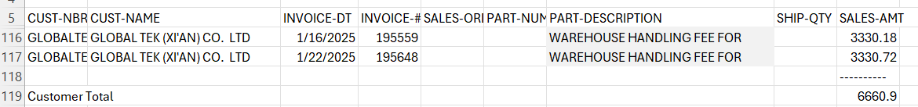
Historical Sales Data Review - continued
Data Fields and Meaning – continued
Should the "Warehouse Handling Fee" be included in the analysis of overall revenue?
Removed "Warehouse Handling Fee"
Suggestion: Consider add a separate table, graphs and forecasting separately, because it has no Volume/ShipQty to report

Slide 35
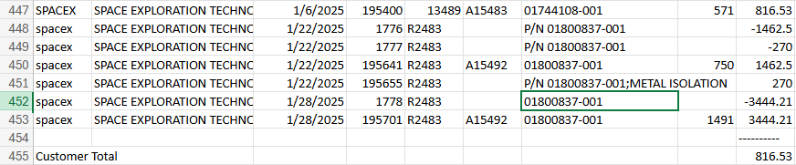
Historical Sales Data Review - continued
2. Data Inconsistencies and Gaps
File Completeness - 1994 data is not in the csv and Power BI. Can this be confirmed?
Returns/Adjustments: The SalesByCustomer 2025 file shows negative Sales-Amt for Space Exploration Tech without a corresponding adjustment in SHIP-QTY. Does a negative sales amount represent a return or an offset for a billing error?
Note: There are several of these but understanding one will help me understand the others.
Team Note: PowerBI has duplicate names cleaned up, but State will need a similar clean-up
Removed records with a blank Ship-Qty. Similar to the Warehouse Handling Fees, consider a separate table and consider when to include/exclude them in the dashboard.

Slide 36
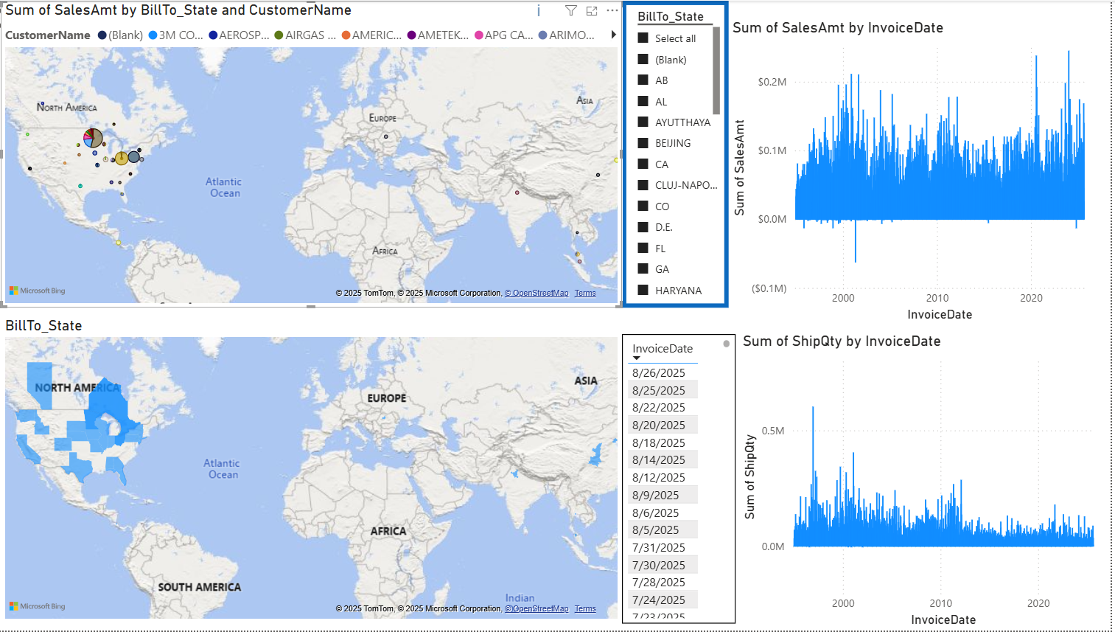
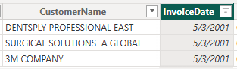
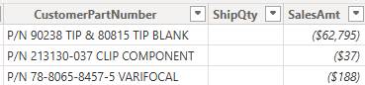
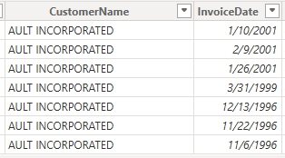
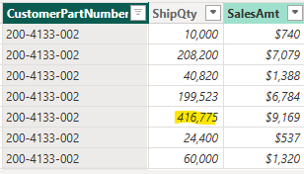
Historical Sales Data: Data Insights - Outliners
P/N records are negative outliners
Large order for $0.02/part - not an outliner,
But last order Feb 2001

Slide 37
2- VMR (Volume, Mix, Rate)

Slide 38
3 - FORECAST

Slide 39
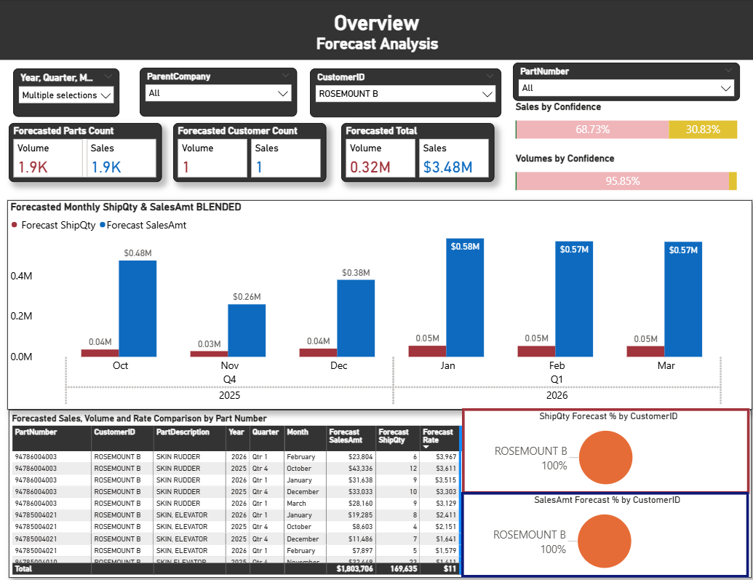
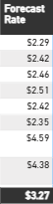

Rosemount B – Forecast Strength: Limited Medium Confidence
Rosemount B forecasts have low Confidence, but 30% has medium Confidence - $1.07M
Why a large difference?
Rosemount C Average Rate Forecast is much lower.
Therefore, Rosemount B displays a bigger difference between Volume and Sales than Rosemont C.
Collin – Rosemount B is driven by higher-value parts than Emerson Rosemount C

Slide 40
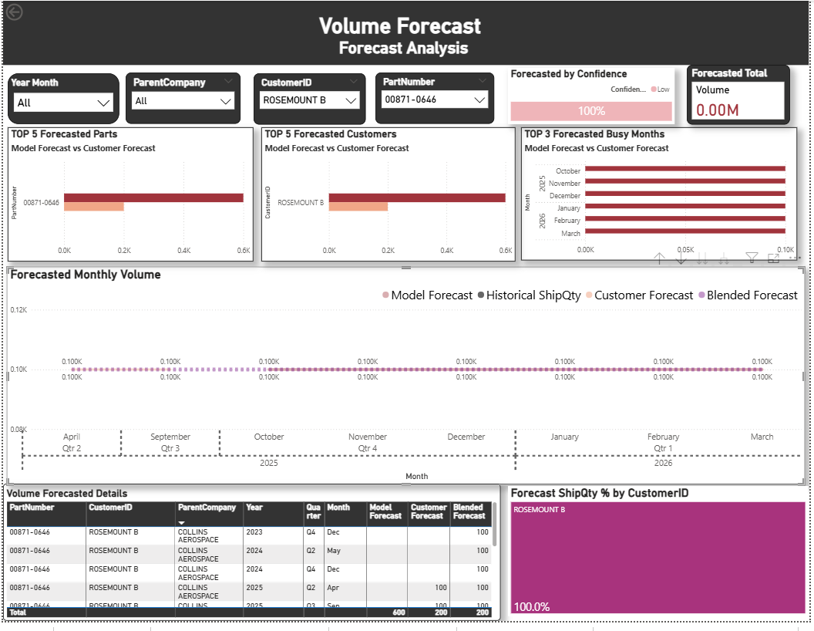
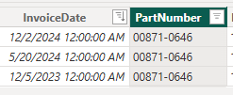
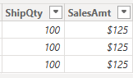
Low Confidence = Unreliable Forecasts
Plate Mount – 000871-0646 only ordered 3 times --> Forecast lacks reliability
Last order Dec 2024 --> May indicate bi-annual or annual demand. This may even be a discontinued part
Low-confidence forecast improve with added history; discontinued parts, bi-annually or annually ordered remain low confidence.

Slide 41
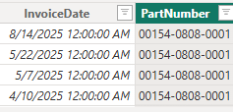
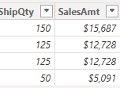
Low Confidence = Unreliable Forecasts
Element Sheath – 00154-0808-001 infrequent orders with increasing volume --> Forecast lacks reliability; that could stay...
Possible Quarterly Shift --> Stronger future forecast .
Unstable order patterns keep forecasts weak

Slide 42
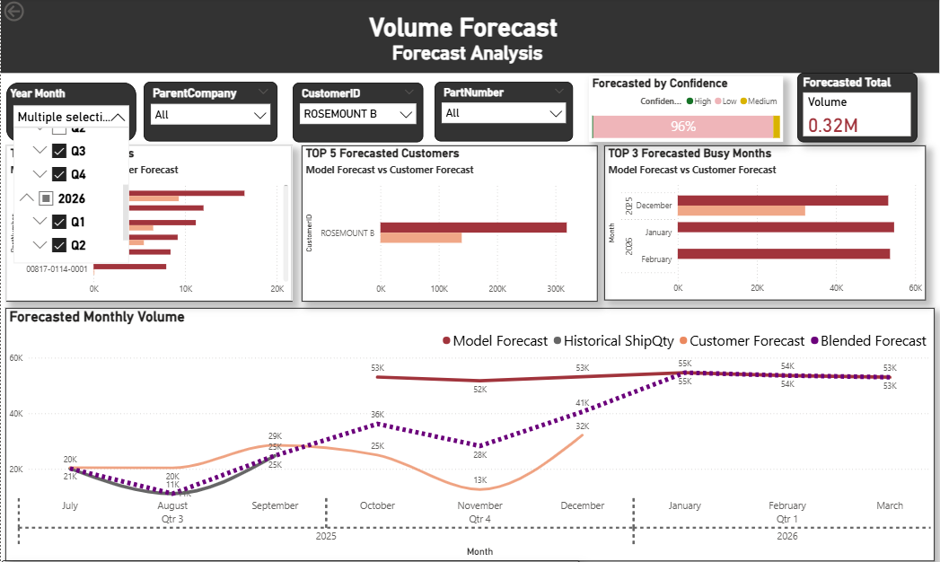
Collin – Rosemount B – Volume Forecast Dashboard
Why isn't there a Customer forecast for January 2026 & February 2026?
Collin File ended December 2025
What are the forecast date ranges used by the project?
Collin files March - December 2025
Emerson file Aug 2025 –Dec 2026
UST Forecast Oct 2025 – March 2026
What if we change the filter to
2025 Q1?
Customer forecast files have different date ranges.

Slide 43
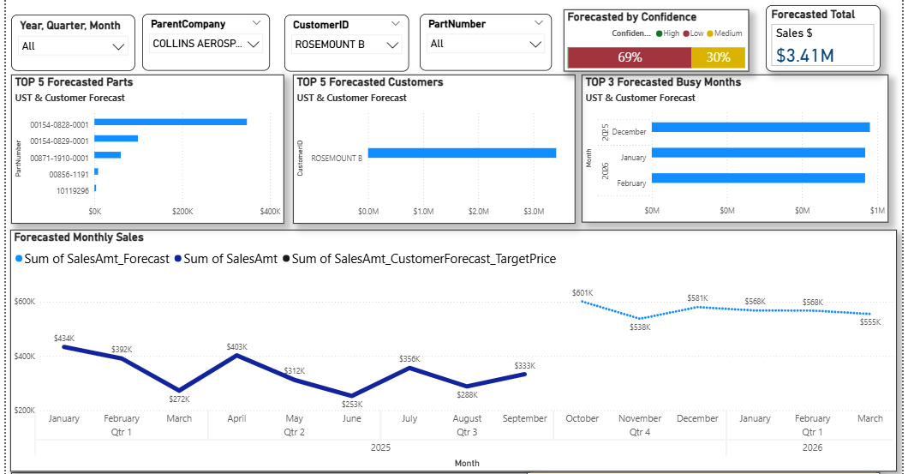

Collin – Rosemount B – Sale Forecast Dashboard
Why is Rosemount B missing Customer Sale Forecast?
Missing Target Prices
SalesAmt_CustomerForecast_TargetPrice is a calculated value
Collin files only include ShipQty (no Sales)
Customer_ShipQty X Target Price = Customer Forecast Sales
Where does the Target Price come from?
_
Collin – Rosemount B latest unit prices are missing, so a sales forecast can't be made.
What if we add the prices?

Slide 44
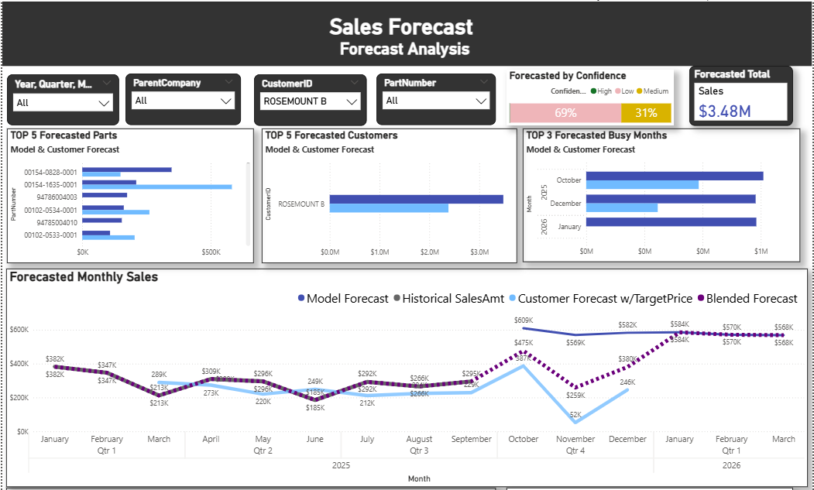
Collin – Rosemount B – Sale Forecast Dashboard
Prices added - Rosemount B has a Customer Sale Forecast?
Higher than the Customer forecast
31% Medium Confidence
69% Low Confidence
Collin – Rosemount B now has sales forecast that is mostly low in confidence.

Slide 45
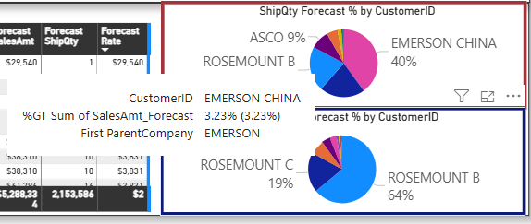
Accelerating Revenue in Strategic Accounts
Strategic Account
Emerson China
Reason
High ShipQty /Low SalesAmt
Details
40% Volume, but only 3.23% Sales stand out as a Strategic Account.

Slide 46
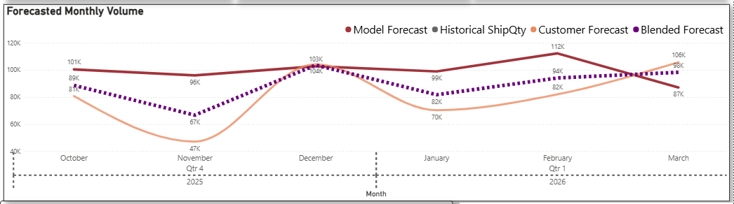
Tracking Forecast Accuracy: November Results, December Expectations
Strategic Account: Emerson China
Results to gather: November volume
Both Forecasting: December with higher volume
Opportunity to compare actual and gain for Q1 forecast.

Slide 47
4- What-If

Slide 48
4 LEAVE BEHIND

Slide 49
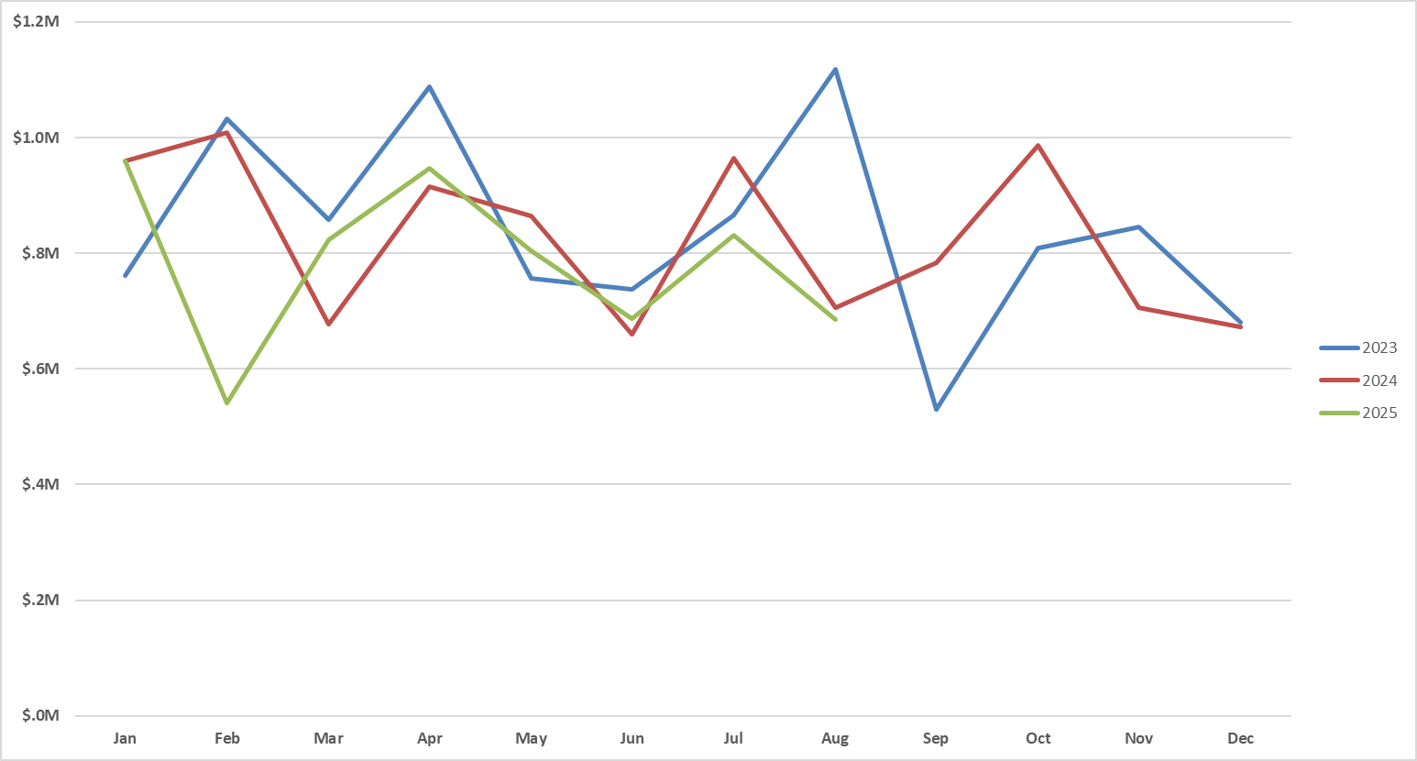
Monthly Sales Trends by Year from 2023-2025
The green line represents 2025 but only includes data from January to August.
A noticeable drop in February 2025 may be due to a data loss incident the company experienced. (February data starts from February 17th).
Sales in other months of 2025 appear consistent with previous years, suggesting strong performance despite the missing data.
Is this drop due to the February data loss?

Slide 50
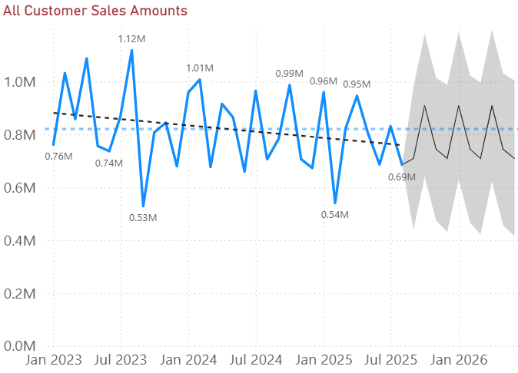
Out of the Box – Power BI Forecasting
Key:
Blue line – Average
Black line – Trend
Grey area - Forecast
Expect peaks Oct '25 Jan '26 April '26
Expect dips Dec '25 Mar '26 June '26
Trend line is negative
Missing inflation, anticipated cost changes, and other key forecasting factors

Slide 51
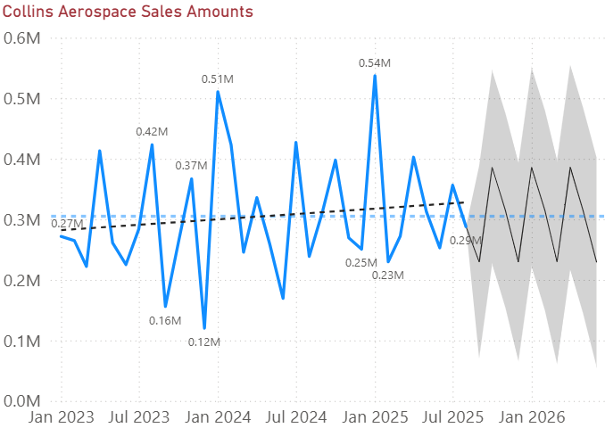
Out of the Box – Power BI Forecasting
Key:
Blue line – Average
Black line – Trend
Grey area - Forecast
Expect peaks Oct '25 Jan '26 April '26
Expect dips Sept '25 Dec '25 Mar '26 Jun '26
Trend is positive
Collin Aerospace is trending positive sales growth – forecasting a dip for this month

Slide 52
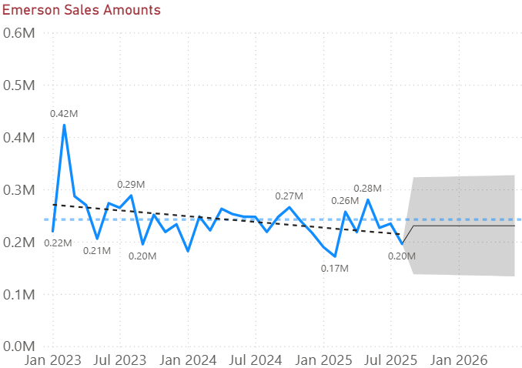
Out of the Box – Power BI Forecasting
Key:
Blue line – Average
Black line – Trend
Grey area - Forecast
Flat forecast just below the average
Trend is negative
Emerson forecasting .23M Sept '25 – June '26

Slide 53
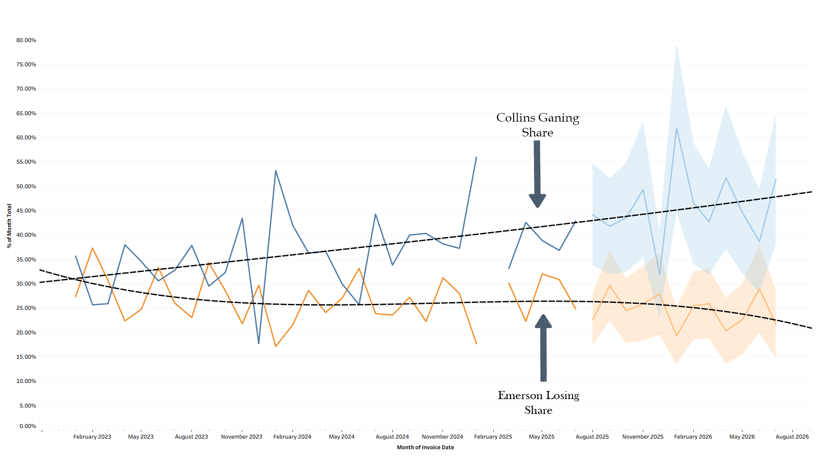
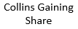
Exploring Tableau Forecasting and Its Broader Applications
Findings:
Collins shows a steady upward trend in share.
Emerson shows a gradual decline in share.
Market shifts Collins.
Collins and Emerson matter most, as together they represent the largest portion of total sales (see appendix).
Percent-of-total calculations were created in Tableau, grouped by month, and trend lines were added to highlight directional changes. This exploratory analysis helps us identify which customer groups are gaining or losing relative share, supporting the design of a forecasting model that captures market shifts. The appendix table confirms that Collins and Emerson together account for the majority of monthly sales, underscoring their importance in forecasting.

Slide 54
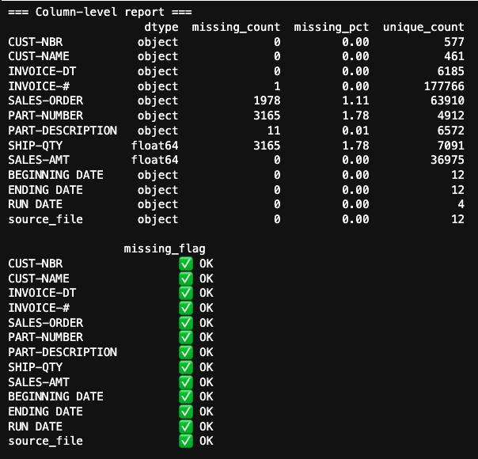
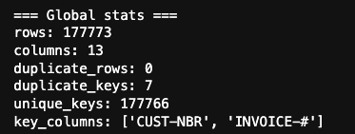
Morgan- Data Intergration & Cleaning &Data Quality Report- appendix
Goal 1: unify multiple sales exports into one clean dataset for Power BI Sales table comparison
Multiple Inputs: CSVs by customer_time period (2000–2002, etc.)
Automated Processing:
Remove invalid rows
(nulls>5, repeated header, "customer total")
2. Extract metadata and attach as columns
(Run Date, Begin Date, End Date)
3. Standardize column types
(IDs->text, amounts->float, dates->string/datetime)
4. Processed files concatenated into one master file
(all_sales_union.csv)
5. Data Quality Report
(missing %, duplicates, unique key checks)

Slide 55
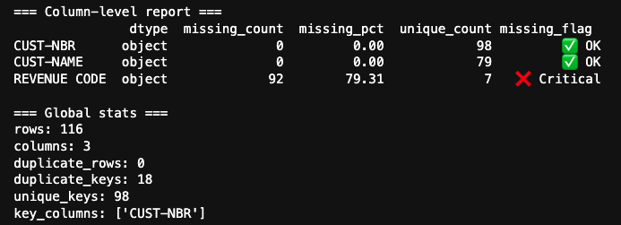
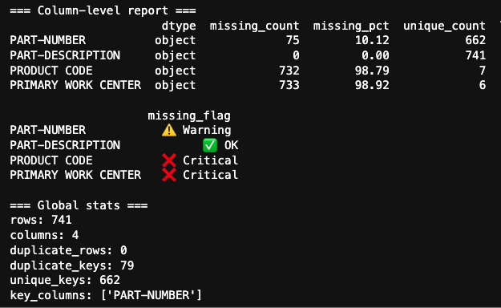
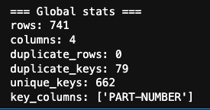
Morgan- Data Intergration & Cleaning &Data Quality Report-appendix
Goal 2: Customer & Part Table Extraction
Inputs: Customer Contracts – Part Cost Info
Customer Dimension (KLESK_cust_extract_from_parts_cost_info.csv)
Extracted: CUST-NBR, CUST-NAME, REVENUE CODE
Applied drop_duplicates() to keep one row per customer–revenue mapping
Added a duplicate check to flag cases where a single CUST-NBR is linked to multiple REVENUE CODEs
Part Dimension (KLESK_cust_extract_from_parts_cost_info.csv)
Extracted: PART-NUMBER, PART-DESCRIPTION, PRODUCT CODE, PRIMARY WORK CENTER
Applied drop_duplicates() to ensure each part is stored once
Added a duplicate check to flag cases where a single PART-NBR is linked to multiple PRODUCT CODEs

